Slide 1

Hadoop Commands
Dr. Supriya Chakraborty
AMITY Institute of Information Technology Kolkata
AMITY University Kolkata

Slide 2
Disclaimer
Read the following before reading…..
This document is solely prepared for the academic purposes of students at Amity University Kolkata.
For further usage, a tangible permission is required solely from the author.
The recipients of this document is advised not to distribute this document freely on the internet.
All the commands and output are elicited with utmost care to be followed by the learners.
Learners are welcome to contribute their findings with command and outputs in this presentation. Their photo identify contributions will also be shared with the next learners\students of this University. Further, negation is also possible

Slide 3
Linux User
Open command prompt
$ java –version
The output of the java version will be shown
$Hadoop version
Hadoop version will be shown
Syllabus

Slide 4
Windows User
Installation guide : https://towardsdatascience.com/installing-hadoop-3-2-1-single-node-cluster-on-windows-10-ac258dd48aef

Slide 5
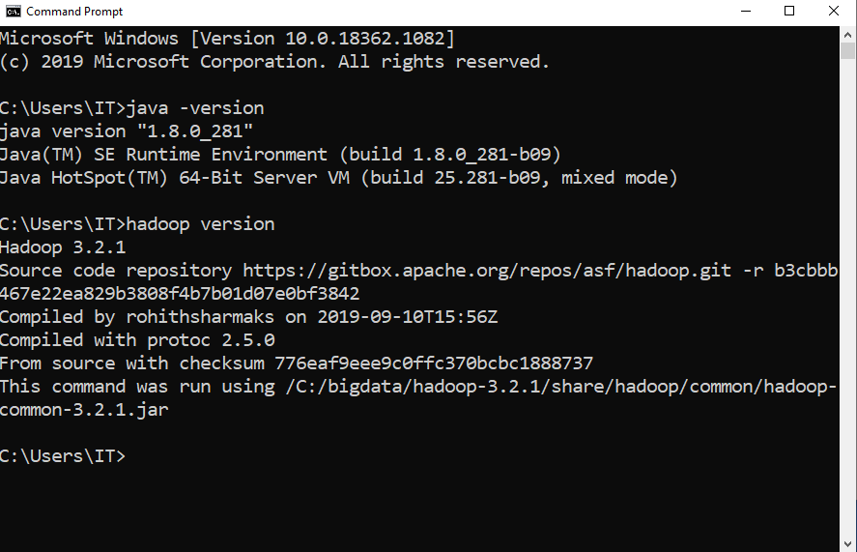
Windows User
Type ‘cmd’ in the Type here to Search and press OK
Run java –version
Run Hadoop version
Path

Slide 6
Formatting the Hadoop File System
Type cd \ -> Move to c:
Type cd bigdata
Cd Hadoop-3.2.1
Cd bin
The final path is c:\bigdata\Hadoop-3.2.1\bin
Type hdfs namenode –format
If there is no error/warning, your formatting is completed.
Do only one time

Slide 7
Start the Hadoop
Type Cd .. -> mode to the parent directory
Type cd sbin -> the final path c:\bigdata\Hadoop-3.2.1\sbin
Type start-dfs.cmd
Two new command prompts will be opened.
Type start-yarn.cmd
Two new command prompts will be opened
Note : ‘.’ implies current directory wheread ‘..’ implies parent directory

Slide 8
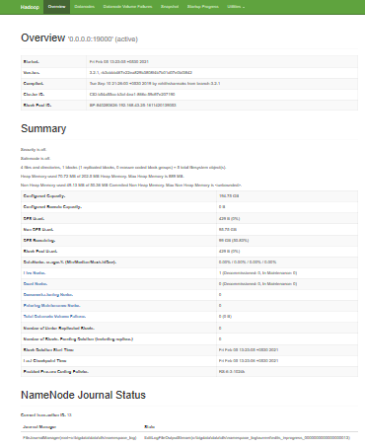
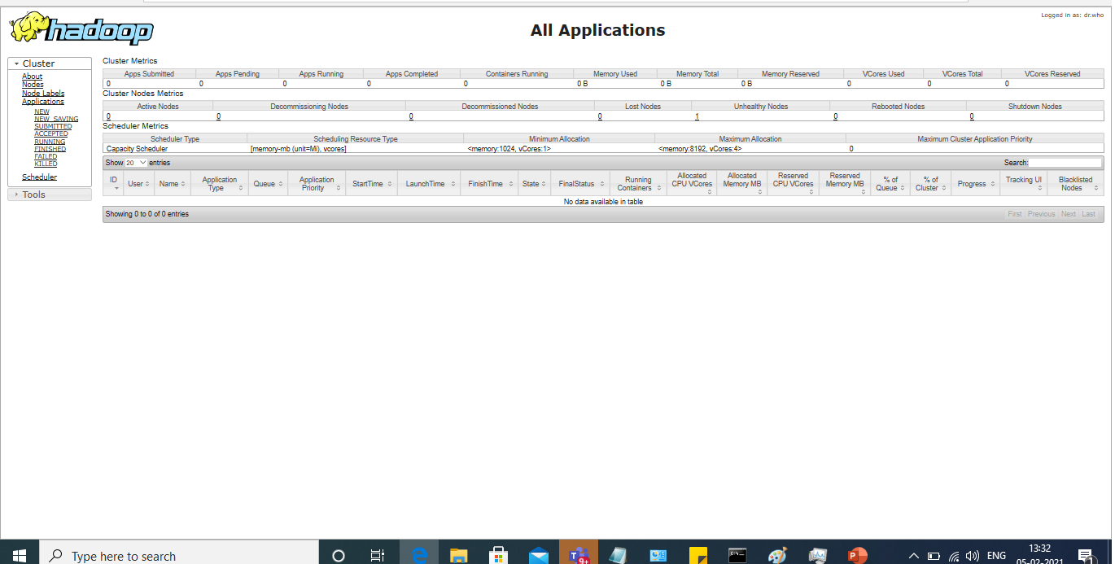
Test the namenode, Datanode, resource manager
See the namenode on http://localhost:9870/dfshealth.html#tab-overview and navigate the UI for the datanode
See resource manager and node manager at http://localhost:8088

Slide 9
Create Directory
hdfs dfs -mkdir /input
Understands the path and destination of the folder.

Slide 10
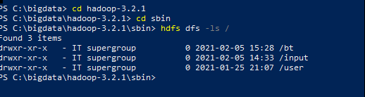
Listing the details of the directory and files
hdfs dfs -ls /
/ is the root of the Hadoop We may think of http://0.0.0.1900: portno communicates
directly to the /.

Slide 11
Create file under directory
Hdfs dfs –mkdir /user
Hdfs dfs –mkdir /user/input
Hdfs dfs –touch /user/input/file.txt

Slide 12
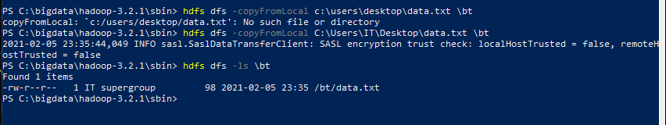
Copy the file outside the Hadoop into it
copyFromLocal
This Hadoop command is the same as put command but here one difference is here like in case this command source directory is restricted to local file reference.
hdfs dfs -copyFromLocal c:\users\IT\data.tx \bt

Slide 13
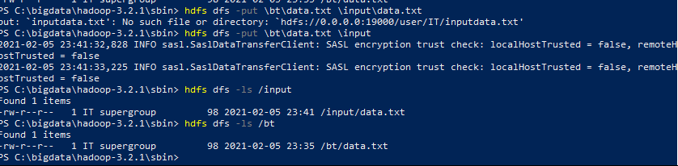
Copy the content
put
This Hadoop Command is used to copies the content from the local file system to the other location within DFS.
hdfs dfs -put /bt/data.txt /input

Slide 14
Fetches all files
. get
This Hadoop Command fetches all files that match the src dir which is entered by the user in HDFS and generates a copy of them in the local file system.
hdfs dfs -get source_dir local_dir?

Slide 15
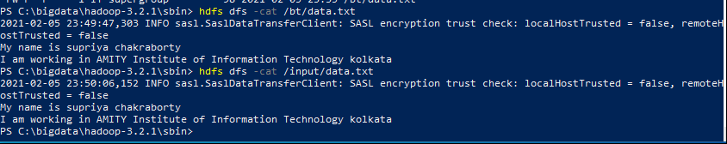
Showing the output of the file
cat
This Hadoop Command displays the content of the file name on the console.
hdfs dfs -cat \bt\data.txt

Slide 16
Concatenate
appendToFile
It appends one and multiple sources from the local file system to the destination and reads from the local stdin also.
hdfs dfs -appendToFile c:\Users\IT\Desktop\Input.txt /bt/data1.txt

Slide 17
Copy from Hadoop to outside
copyTOLocal
This Hadoop Command is using the same as getting command but one difference is that in this the destination is limited to a local file path.
hdfs -dfs -copyToLocal src_dir local_dir

Slide 18
Cut
. mv
This Hadoop Command moves the file and directory one location to another location within hdfs.
hdfs fs -mv source_dir_filename destination_dir

Slide 19
Copy
cp
This Hadoop command copies the file and directory one location to other locations within hdfs.
hdfs fs -cp source_dir_filename destination_dir

Slide 20
Cut to/from Hadoop
moveFromLocal
It copies content from the local file system to a destination within HDFS but the copy is a success then deletes content from the local file system.
hdfs dfs -move from local local_src destination_dir
move to local
This Hadoop command runs as -get commands but one difference is that when the copy operation is a success then delete the file from HDFS location.
move to local source_dir local_dir

Slide 21
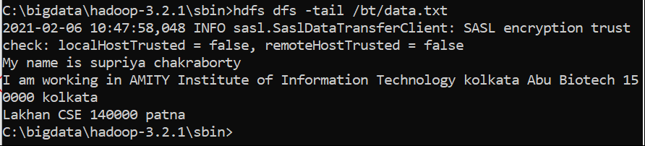
Only the beginning of the file
tail
It displays 1 KB content on the console of the file.
hdfs dfs -tail /bt/data.txt

Slide 22
Remove
rm
It removes files and directory from the specified path.
hdfs dfs -rm dir_name

Slide 23
Empty the Trash
expunge
This is used to empty the trash.
hdfs dfs -expunge

Slide 24
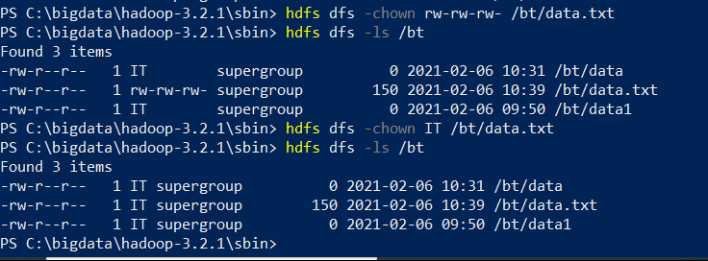
Ownership of the file
. chown
It used to change the owner of files or rwx permission on files. We can also use it by -R for recursively.
hdfs dfs -chown rw-rw-rw- /bt/data.txt
Hdfs dfs –chown IT /bt/data.txt

Slide 25
Changing the group
chgrp
This is used to change the group of files. We can also use it by -R for recursively.
hdfs dfs -chgrp group_name dir_name

Slide 26
Display the disk usage
du
This displays disk usage for all files available in the present directory with the path given by the user and prints information in bytes format.
hdfs dfs -du dir_name

Slide 27
Display the free space
df
This Hadoop Command displays free space.
hdfs dfs -df -h

Slide 28
Timestamp
touchz
This is used to create a file with a path and includes current time as timestamp and is also the path is exiting if exits then fail to create process.
hdfs dfs -touchz dir_name

Slide 29
Count the number of file and directories
count
The output columns with -count are: DIR_COUNT, FILE_COUNT, CONTENT_SIZE FILE_NAME
The output columns with -count -q are: QUOTA, REMAINING_QUATA, SPACE_QUOTA, REMAINING_SPACE_QUOTA, DIR_COUNT, FILE_COUNT, CONTENT_SIZE, FILE_NAME

Slide 30

Statistical information on Path

Slide 31
Error if any
checksum
It returns checksum information of a particular file.

Slide 32
Thank you
Practice all the shell commands of the Hadoop to understands its functioning. Learners also expected to experiment with options that are not part of the slides. In case you find, something really interesting and wants to include in this slide, communicate with me. Your name is also referred while discussing the point.

